Slide 1


SNAKE GAME IN JAVA
PRESENTED BY
2303811710421146 – SHERWIN B
GUIDED BY
Mr. MALARMANNAN A AP/CSE

Slide 2

PRESENTATION OVERVIEW
Objective
Project Introduction
Problem Statement
Methodologies (Programming concepts relevant to problem statement)
Architecture of the proposed system
List of Modules
7. Merits
8. Results and Discussion
9. Queries

Slide 3
OBJECTIVE
The game might also lag due to an inefficient loop, and food may not always appear in the right spots
The challenge is to create a version of the Snake game using Java that is interactive, scalable, and fun.
The game should focus on smooth performance, intuitive controls, and responsive design.

Slide 4
PROJECT INTRODUCTION
The Snake Game is a classic arcade game recreated in Java using Swing/JavaFX for a dynamic graphical user interface.
The game features smooth animations, responsive controls, and a scoring system that tracks points for food consumed, with the speed increasing as gameplay progresses to add difficulty.
Built with modular design, it utilizes core Java concepts such as object-oriented programming, event handling, and threading.
This project serves as an engaging way to enhance programming skills in game development and GUI creation while providing a solid foundation for building more advanced applications.

Slide 5
PROBLEM STATEMENT
The game might also lag due to an inefficient loop, and food may not always appear in the right spots
The challenge is to create a version of the Snake game using Java that is interactive, scalable, and fun.
The game should focus on smooth performance, intuitive controls, and responsive design.

Slide 6
Methodologies (Programming concepts relevant to problem statement)
Object-Oriented Programming (OOP):
Classes and Objects: Snake, Food, and GameBoard are implemented as classes.
Encapsulation:
Game logic and GUI rendering are encapsulated in respective classes.
Swing Framework:
Used for the graphical user interface, including the game window and rendering.
Event Handling:
Implemented using KeyListener for user input (arrow keys for movement).
Multithreading:
Timer-based game loop using javax.swing.Timer for smooth updates.
Collections:
LinkedList to represent the snake's body for efficient growth and movement.

Slide 7
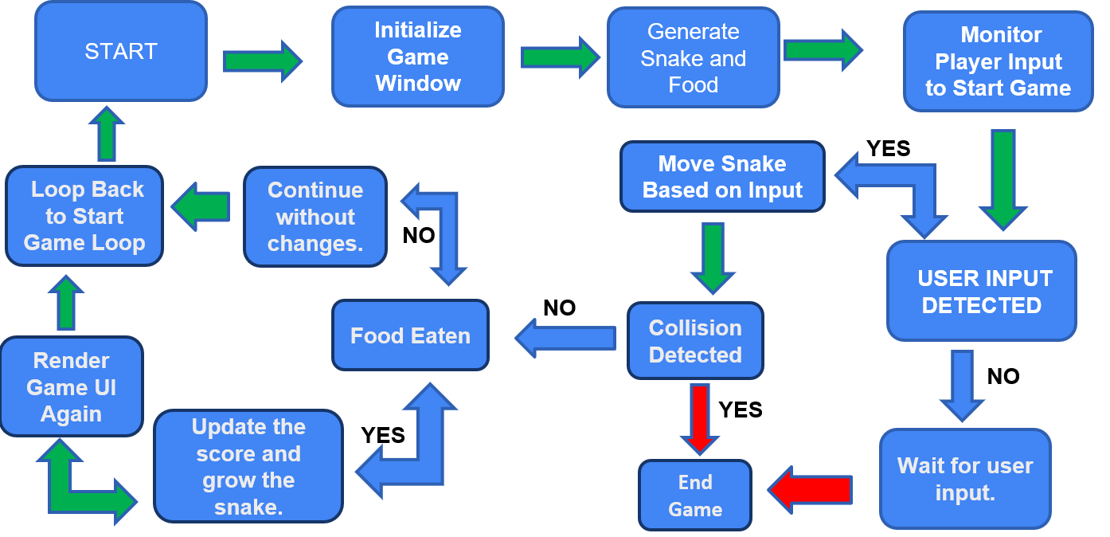
FLOW DIAGRAM

Slide 8
MODULE DESCRIPTION
Main Class
Initializes the game by creating a JFrame window and adding the GameBoard panel.
Starts the game loop.
GameBoard Class
Manages the game’s main logic and rendering.
I Implements ActionListener for the timer and KeyListener for movement.
Snake Class
Maintains the snake’s position and length using a LinkedList.
Provides methods to grow and move the snake.
Food Class
Randomly generates food coordinates within the grid.
Scoring System
Tracks the player's score, incrementing it with each food consumption.
Displays the score on the game window.

Slide 9
MODULE DESCRIPTION
Game Engine:
Handles the game loop, movement, and collision detection.
Graphics Module:
Responsible for rendering the game components such as the snake, food, and background.
Input Module:
Manages player input for controlling the snake's movement.
Score Module:
Tracks and displays the player’s score.
Collision Handler:
Detects snake collisions with walls and itself.
Food Generator:
Randomly places food items on the game grid.

Slide 10
MERITS
Interactive and Engaging Gameplay:
The game provides a smooth and responsive user experience with dynamic visuals and real-time controls, keeping players engaged.
Practical Application of Programming Concepts:
Implements core Java concepts such as object-oriented programming, event- driven programming, and threading, making it an excellent learning project.
Modularity and Scalability:
The modular design allows for easy extension with new features like obstacles, power-ups, or custom difficulty settings.
Cross-Platform Compatibility:
Built with Java, the game is platform-independent and can run on any system with a Java runtime environment.

Slide 11
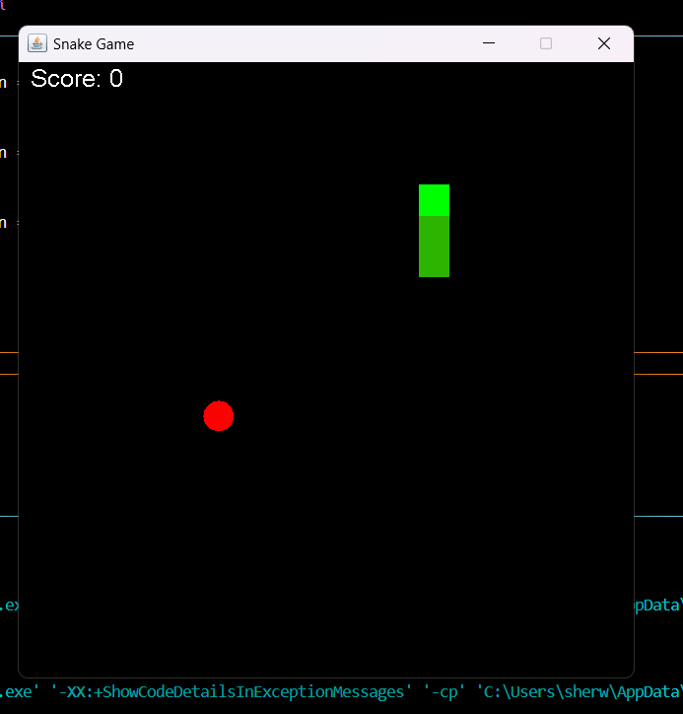
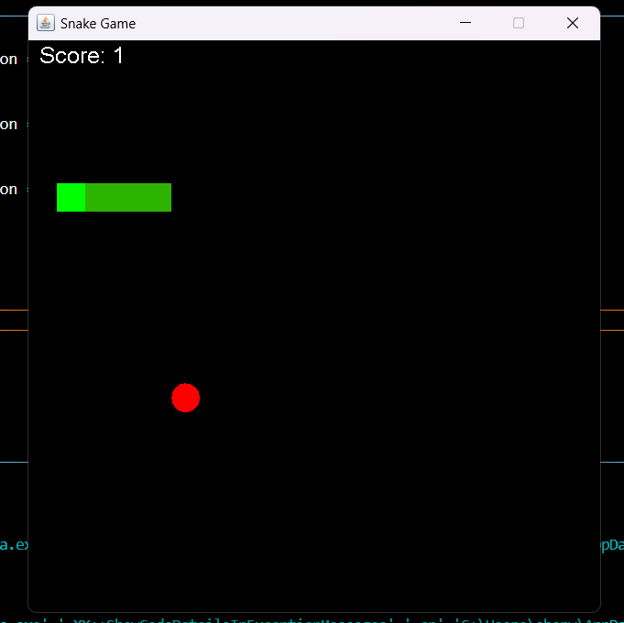
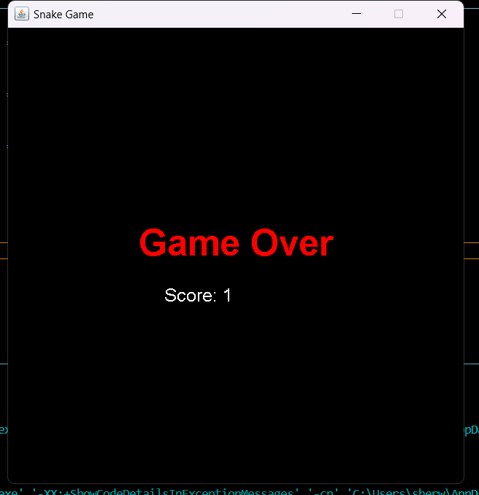
RESULT AND DISCUSSION

Slide 12
ANY QUERIES ?

Slide 13
THANK YOU

